Slide 1
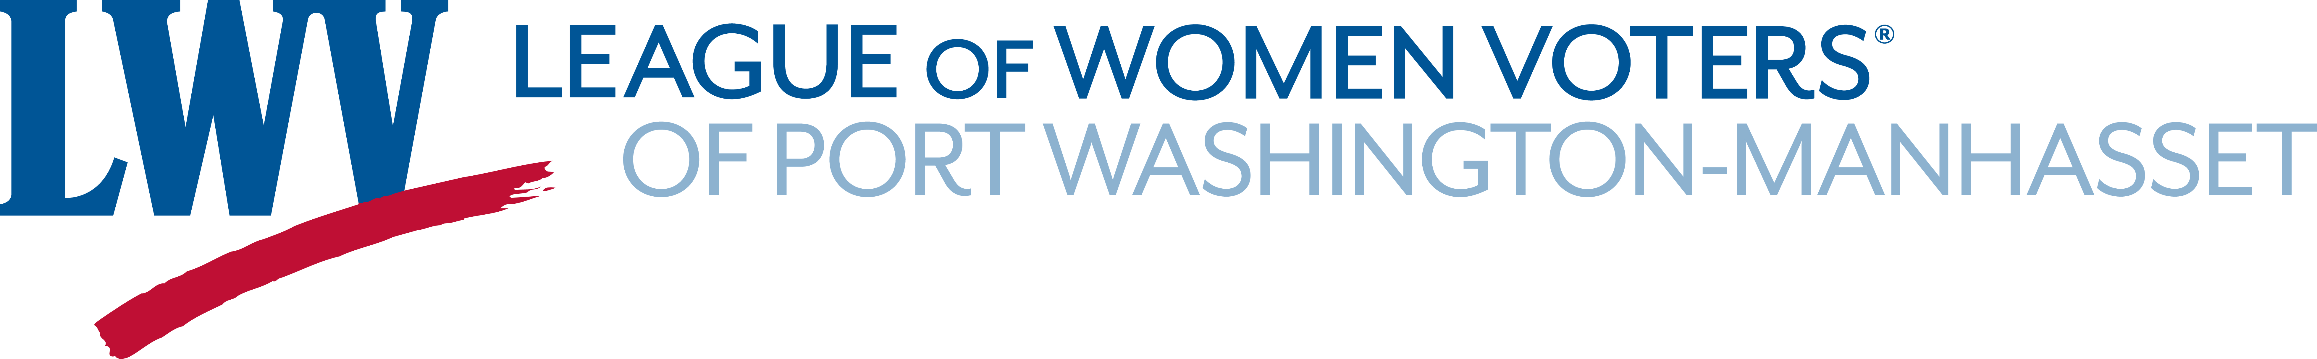
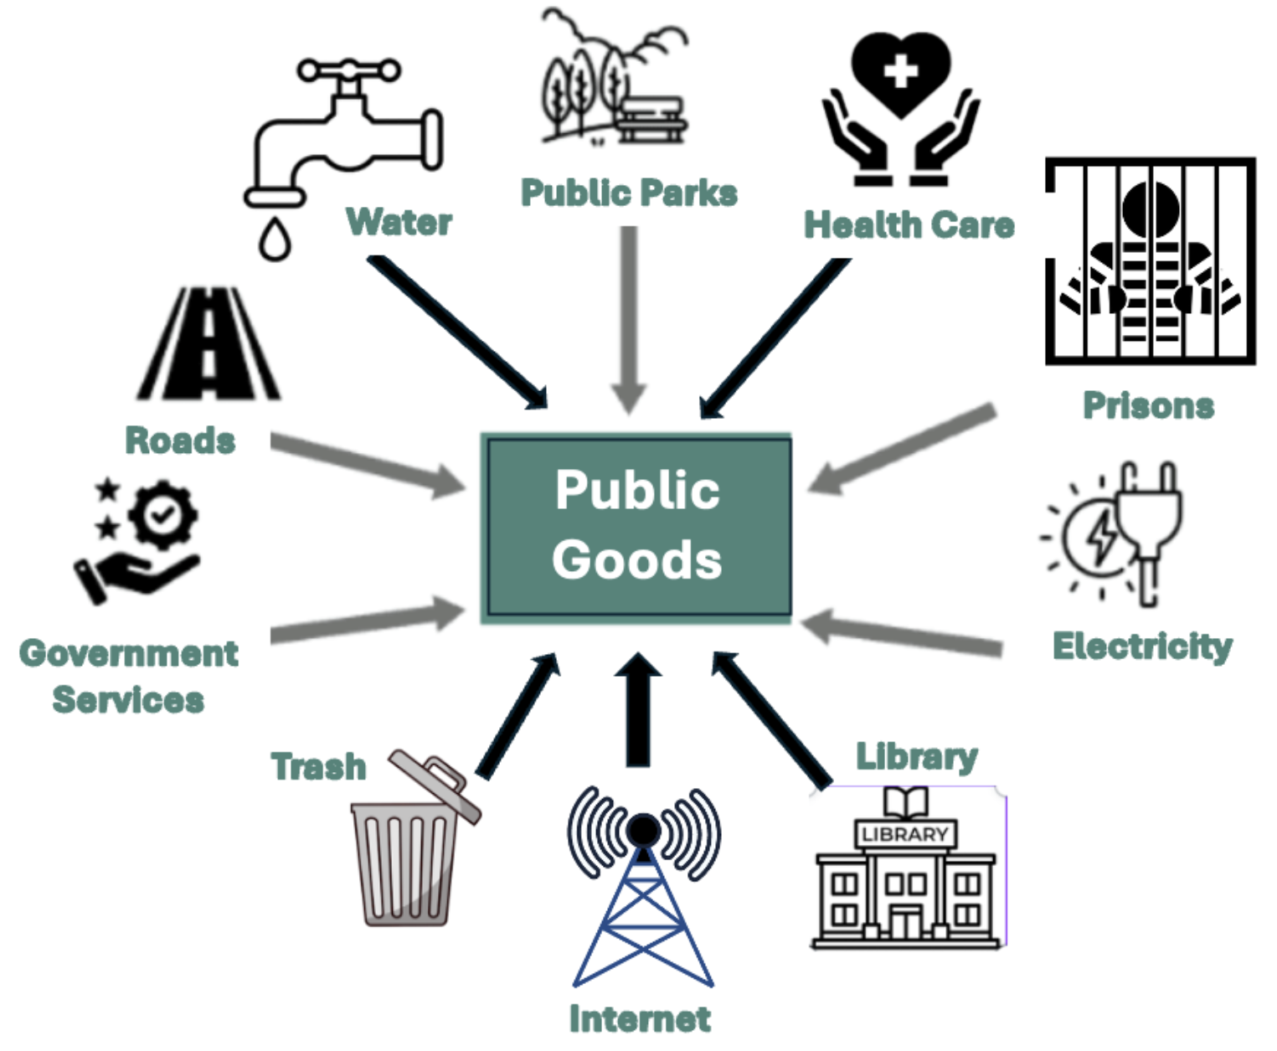
Proposed Update to
LWVUS Privatization Position
Judith B. Esterquest, PhD,
HCR4US Team Partners (≈45 States),
& More Than 95 Supporting State & Local Leagues
2 June 2026
Delegate Preparation for Convention

Slide 2
Please write on the back of a card
Your name and state
Is this your first Convention? (or 2nd or 3rd ...?)
What questions or concerns do you have, if any, about voting YES for this Update?
Would you consider volunteering to mobilize support — among delegates from your state or other states?

Slide 3
Quick Intro: LWV Definitions
What is a League position?
  A POLICY statement, formally adopted after rigorous study, reaching consensus on language, and adopted by vote of membership
  It GUIDES advocacy —to oppose or support legislation/regulation
  It does not REQUIRE advocacy, but having it ALLOWS advocacy
What does “by concurrence” mean?
  When a League adopts a position that was studied, drafted, and adopted by another League, it’s “by concurrence.” No additional study is needed.
  Concurrence requires “yes” or “no” on the entire position, exactly as is.
Does this process happen often?
Yes, e.g., 2022 Convention delegates adopted “by concurrence”
  “Recommended” to delegates: NY Health Care Update, CA Criminal Justice
  “Not Recommended” to delegates: CT Digital Equity

Slide 4

Clarification
In the Convention Workbook, this is named:
“Privatization/Health Care”
Clarification:
It proposes amending the Privatization position
It is NOT about health care, per se, but about
Ownership and control of public goods
  Bringing the Privatization into alignment with other positions in Impact on Issues
  Recognizing health care as the most privatized of all American public goods

Slide 5
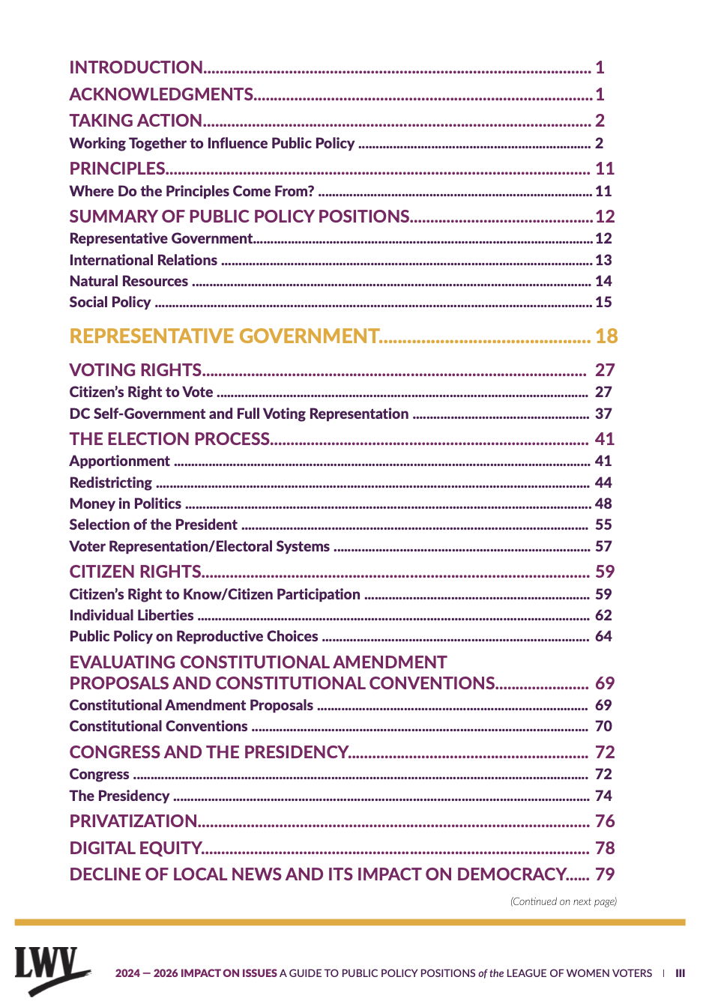



Quick Intro:
Peruse Table of Contents (& clickable page numbers)
Notes:
We’ve noticed that there is confusion about what this update is changing.
It is changing the Privatization position in the Category of Representative Govt
It is NOT changing the Health Care position in the category of Social Policy — the HC policy already supports moving to publicly funded (via taxes) as
Offering more “equitable access, affordability, and financial feasibility“ than privatized health care
There are 4 changes and two of them address healthcare … and two are broader than hc, addressing all the areas of public good covered by the position

Slide 6
This is NOT a Health Care proposal, despite HC advocates bringing it
HC advocates — from across the country
Legislative reforms we care about involve regulating private ownership/control by bad actors
Like Willie Sutton, Private Equity has acquired $1 Trillion in HC assets over the past decade
No LWV Public Good Interest Group exists — the current position effectively silos & silences advocacy
It is the ONLY position without legislative history
Without a position to support advocacy, members cannot support or oppose relevant legislation
We need to make the Position useful

Slide 7
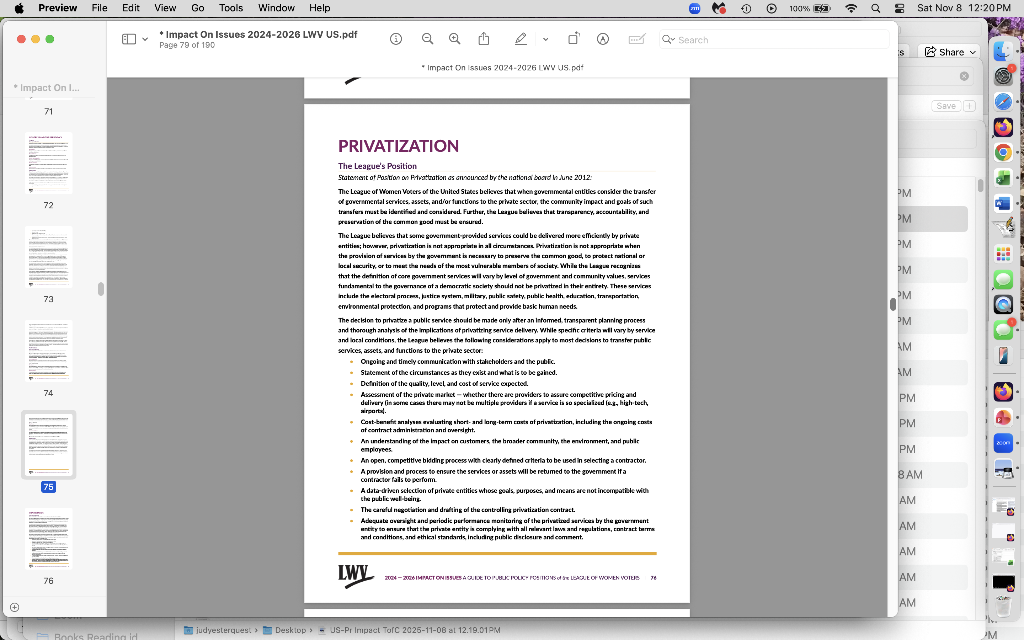

Quick Intro:
Position vs History
Notes:
No history … hasn’t been much used in 13 yrs, despite our economy experiencing accelerated privatization of public goods and services
Compare to HC position — 3 pages of position and 9 pages of history, 5 since the privatization position was introduced

Slide 8
Health Care is the most privatized of all public goods
35% of Americans are covered by public programs — and within those public programs:
78% of Medicaid enrollees are in (private) Managed Care Organizations,
50% of Medicare beneficiaries are in Medicare Advantage (fully private programs),
53% of Traditional Medicare beneficiaries see providers in (private, often invisible) "accountable care" relationships
40% of veterans get healthcare outside the VA

Slide 9
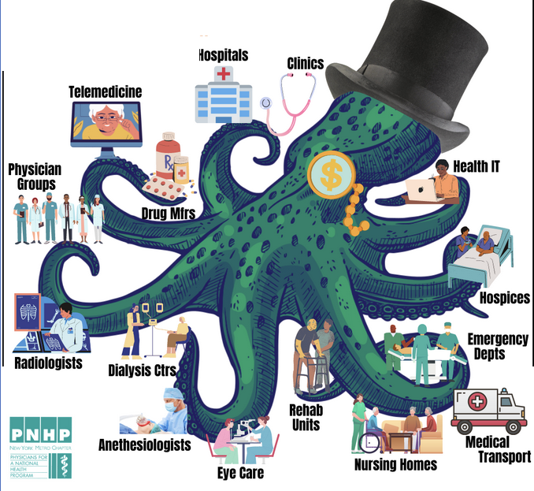
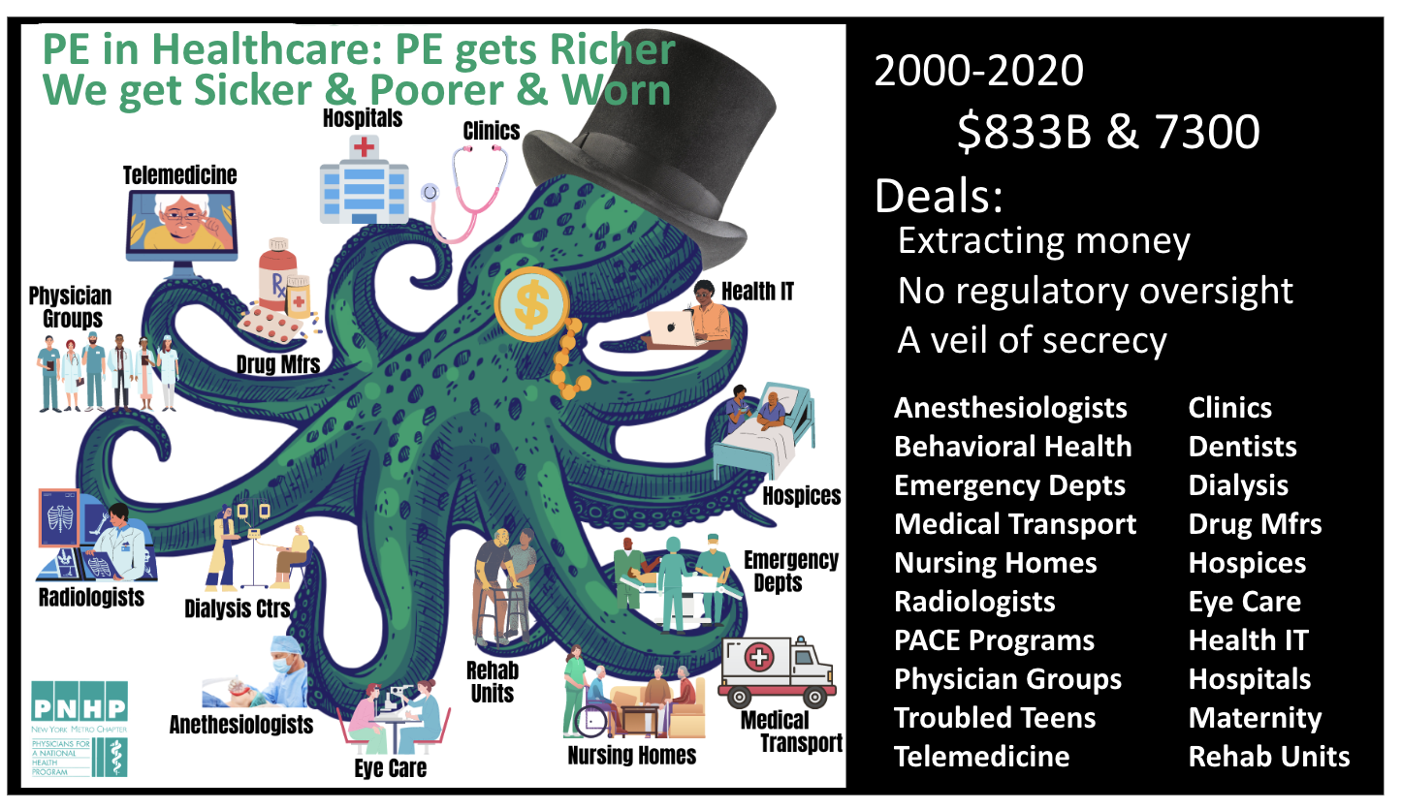

HC is the most privatized of all public goods — the tip of the iceberg
Private Equity targets inelastic demand: your money or your life
2000-2020:
$833 Billion & 7300 deals
Notes:
…This is from an educational forum in October 2022 — led by a researcher at the Cornell School of Labor Relations who has studied private equity investment and practices for more than a decade … before the FTC began suing Private Equity monopolies such as
Anesthesia cartel … TX
ER cartel … states
Note the expanse of PE investments across the entire health sector — including ambulances, residential programs for trouble teens and behavioral care, hospices, dialysis, dentists and telemedicine …

Slide 10
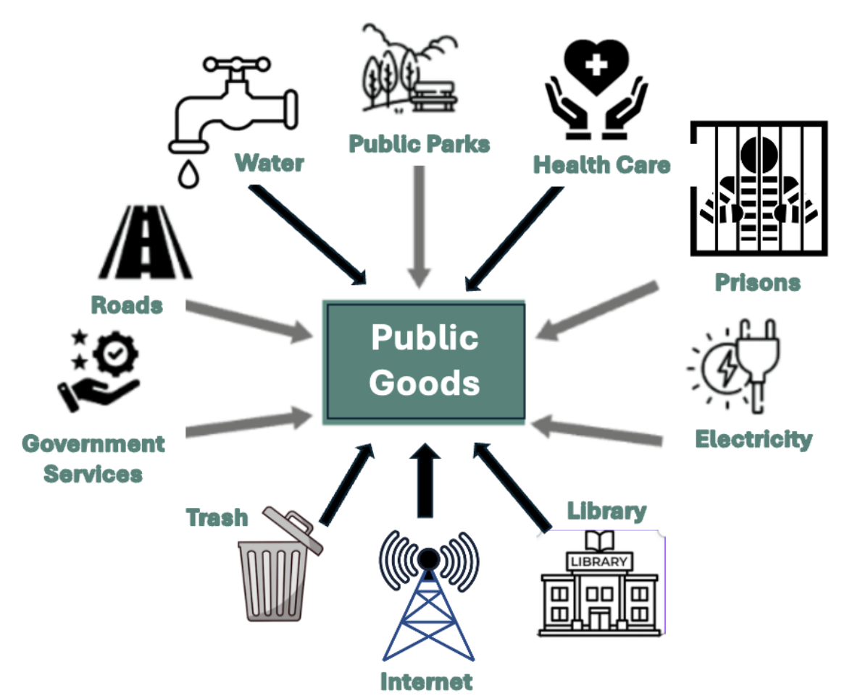
Across the country, public goods are increasingly privatized:
higher cost, with reduced service, safety, transparency, access
  Rural and municipal broadband
  Municipal water
  Trash pickup/disposal
  Energy grid and/or distribution
  Libraries
  Parks
  Parking and road repair
  Prisons, jails, detention centers or their management
  Probation (with fees like payday lenders)
  Housing (corporate monopolies drive up cost )
Notes:
The National League signed on a letter to the three federal agencies list sent in June 2024 —

Slide 11
Current LWVUS Position(s)
Representative Govt — Privatization (2012)
  Sets out LWV requirements for transferring public goods to private control
  Defines & Lists “Common Goods”
  One-sided scope: what can LWV support in transferring public goods to private sector — no clarity around reversing for “fails to perform”
  No History of Use
Public Health” studies & makes recommendations at the population level: e.g., what shots should infants/elderly get? Community-wide disease prevention
“Health Care” focuses on clinical medicine, individual patient care
e.g., your provider offers you the shot unless contra-indicated for you

Slide 12
What Is the LWVPWM Update?
The LWV of PWM believes that healthcare, like other programs that provide and protect basic human needs, should be considered a public good.
The League favors a system where fiduciary responsibility (for such programs) is to patients and the public. Because private
for-profit corporations have a fiduciary responsibility to their shareholders rather than to patients or public health, the League believes the for-profit business model for healthcare is inappropriate for the common good or to meet the basic needs of the most vulnerable members of society. In sum, the League opposes further privatization of needed healthcare.
Where private entities fail to deliver programs that
provide and protect basic human needs, the League supports de-privatizing them.
Notes:
Current US position offers robust criteria for determining
if privatization is warranted and
how privatized services might be regulated
But is not explicit about recourse for any failure to meet criteria

Slide 13
Current LWVUS Position(s)
Representative Govt — Privatization (2012)
  Sets out LWV requirements for transferring public goods to private control
  Defines & Lists “Common Goods”
  One-sided scope: what can LWV support in transferring public goods to private sector
  No History of Use
Social Policy —
Health Care (1993 +)
  LWV Goal: affordable, quality health care for all residents
  Sets out types of care, delivery, patient choice, acceptable financing for individual coverage
  Wide scope: Principles for what the LWV can support or oppose in health reform bills
  2500 Words of History
”Public Health” studies & makes recommendations at the population level:
Listed in Privatization. No discussion in Health Care.
“Health Care” focuses on clinical medicine, individual patient care:
Omitted in Privatization, despite being a public good.

Slide 14
Why Update the Position
Explicitly
Aligns the position to Impact on Issues by including Health care in the list of public goods
Allows opposing further privatization of HC
Includes an accountability standard:
Fiduciary Responsibility to the public
(not just investors)
4. When private interests control public goods: Fiduciary Responsibility carries an obligation to prioritize the well-being of the public (particularly the vulnerable) over private interests (maximizing profit, investor returns, executive pay, marketing/promotion, etc.)

Slide 15
Case Examples: Do We Need This Update?
Pending NYS Legislation: Prohibiting Private Hospices
  2023 & 2024: we sought to advocate for the bill —
  “No LWV position supports prohibiting new for-profit facilities”
  2025: NYS adopts this Update — by acclamation
  2026: NYS prioritized 5 bills using this position:
    Manufacturing Drugs In-House Transparent Corp Structure Prohibiting New Private Hospices Insourcing Medicaid LTC
    Prohibiting New Private Nursing Homes
  Late 2025 & 2026 A sister Long Island League has used it to oppose local legislation alienating public parkland with old growth forest
and a neighboring League has used them locally in their fight to keep from alienating into private hands one of the last remaining “old-growth forest and wetlands ” on LI …
Notes:
Overwhelming evidence-based research:
private hospices offer fewer services, less trained staff, more complaints, higher rates of ER use, more likely to discharge patients, including those with dementia — and cost NYS more.
Nursing homes: Overwhelming evidence-based research: private nursing homes have more bed sores, falls, infection controls, patient deaths — and cost NYS more.

Slide 16

Questions?
Concerns?
Will YOU help us get this adopted?

Slide 17
Thank you!
Vote YES
Today
To Consider the
Privatization Update
Vote YES
Tomorrow
To Adopt the
Privatization Update

Slide 19
LWVUS Privatization Position — with illustration of how to insert LWVPWM Update
… The League believes ... Privatization is not appropriate when the provision of services by the government is necessary to preserve the common good, to protect national or local security or to meet the needs of the most vulnerable members of society ... These services include the electoral process, justice system, military, public safety, health care, public health, education, transportation, environmental protection, and programs that protect and provide basic human needs….
Best practices for government regulation of the privatization process should include the following requirements:
[7 required “best practices” deleted]
The League opposes further privatization of needed healthcare.
The League favors a system where fiduciary responsibility (for managing public goods) is to patients and the public.
Where private entities fail to deliver programs that provide and protect basic human needs, the League supports de-privatizing them

Slide 20



June 2024
Letter from
LWV of US
& 200 allies
LWVUS letter to FTC, DOJ, HHS: concluding paragraphs
PE and health care are incompatible: …
spiraling prices,
diminished access, and
declining quality, including unnecessary illness, injury, death.
  The essence of health care
  — an ethical commitment by autonomous, highly trained professionals to the improvement and well-being of their patients and clients —
  is undermined by PE’s financialization strategies that emphasize maximizing profits above all.
www.lwv.org/health-care-reform/league-joins-comments-regarding-consolidation-healthcare-markets
Notes:
The National League signed on a letter to the three federal agencies list sent in June 2024 —

Slide 21
June 2024
Letter from
LWV of US
& 200 allies
LWVUS letter to FTC, DOJ, HHS: concluding paragraphs
Markets function best with competition and a free flow of information about prices and quality.
The health care system functions best when
everyone has adequate access to care and decisions are made in the best interest of patients and communities, rather than owners and investors seeking to maximize financial return.
The unfettered pursuit of profit is unhealthy for the American economy and for the communities that suffer…
We thank the FTC, DOJ, and HHS … and urge them to act
www.lwv.org/health-care-reform/league-joins-comments-regarding-consolidation-healthcare-markets
Notes:
The National League signed on a letter to the three federal agencies list sent in June 2024 —
These sentences are from the concluding paragraph

Slide 22
Case Examples: Do We Need This Update?
Pending NYS Legislation: Prohibiting Private Hospices
  2023 & 2024: we sought to advocate for the bill —
  “No LWV position supports prohibiting new for-profit facilities”
  2025: NYS adopts this Update — by acclamation
  2026: NYS prioritized 5 bills using this position:
    Manufacturing Drugs In-House Transparent Corp Structure Prohibiting New Private Hospices Insourcing Medicaid LTC
    Prohibiting New Private Nursing Homes
  Late 2025 & 2026 A sister Long Island League has used it to oppose local legislation alienating public parkland with old growth forest
and a neighboring League has used them locally in their fight to keep from alienating into private hands one of the last remaining “old-growth forest and wetlands ” on LI …
Notes:
Overwhelming evidence-based research:
private hospices offer fewer services, less trained staff, more complaints, higher rates of ER use, more likely to discharge patients, including those with dementia — and cost NYS more.
Nursing homes: Overwhelming evidence-based research: private nursing homes have more bed sores, falls, infection controls, patient deaths — and cost NYS more.

Slide 23
Case Examples: Do We Need This Update?
Pending NYS Legislation: Prohibiting Private Hospices
  2023 & 2024: we sought to advocate for the bill —
  “No LWV position supports prohibiting new for-profit facilities”
  2025: NYS adopts this Update — by acclamation
  2026: NYS prioritized 5 bills using this position:
    Manufacturing Drugs In-House Transparent Corp Structure Prohibiting New Private Hospices Insourcing Medicaid LTC
    Prohibiting New Private Nursing Homes
  Late 2025 & 2026 A sister Long Island League has used it to oppose local legislation alienating public parkland with old growth forest
and a neighboring League has used them locally in their fight to keep from alienating into private hands one of the last remaining “old-growth forest and wetlands ” on LI …
Notes:
Overwhelming evidence-based research:
private hospices offer fewer services, less trained staff, more complaints, higher rates of ER use, more likely to discharge patients, including those with dementia — and cost NYS more.
Nursing homes: Overwhelming evidence-based research: private nursing homes have more bed sores, falls, infection controls, patient deaths — and cost NYS more.

Slide 24



Please Vote “YES” at Convention:
PWM/NYS Update to Privatization
Learn more:
      Websites — (will include Convention FAQs soon)
    https://lwvofpwm.org/concurrence-privatization-update/
    https://lwvhealthcarereform.org/ny-concurrence-page-2026/
    Webinar recordings
    bit.ly/videos-Update-Privatization
  Questions? LWV.Update4Convention@gmail.com
  THANK YOU!

