Slide 1
Health Care Concurrence What you need to know before LWV 2022 Convention
Barb Thomas, LWV of Saratoga (NY) Judy Esterquest, LWV of Port Washington-Manhasset (NY)
February 5, 2022 Hosted by LWV of Colorado
Notes:
Thank you for your time today. And thank you to the League of Colorado (and Linda Mahan) for
hosting this event.
I’m Barb Thomas from the League of Women Voters of Saratoga County, NY and my Co-presenter is
Judy Esterquest from the League of Port Washington/Manhasset also in NY.
We were both members of the Healthcare Update Committee that developed the New York State
League’s new Healthcare Positions….

Slide 2
Agenda
2
What are Leagues being asked to do?
What is the LWV concurrence process?
LWV health care: Why update?
How did LWVNY update its Healthcare positions?
What does the concurrence add?
What are the effects of inequitable access?
What would universal access mean?
Where to learn more
Notes:
Excerpts from those NY positions form the Concurrence Statement that we are asking you to recommend for consideration at the national Convention this June.
We’re glad you have joined us today to cover this ambitious agenda.

Slide 3
Please
3
Put your NAME and
LEAGUE name
in the chat now
Thank you.
Notes:
We’d like you to list your local League in the chat right now — so we know where you’re from — and to save time we are going to ask you to hold your questions till the end, but you can put them in the chat as we go

Slide 4
What are Leagues being asked to do:
Ask US Board to make this concurrence a recommended item for program consideration at Convention: “Adding language excerpted from the 2021 LWVNYS Positions on Healthcare and Financing Healthcare”
Include this Recommendation on LL Program Planning Report Form (online survey, due Mar 1st)
Note: If enough Leagues recommend this Concurrence, it will be brought to the floor of the Convention for discussion and a vote
4
Notes:
What exactly are we asking you to do? Mainly, we’re asking you are to recommend this Concurrence for consideration at the Convention by putting it on your League’s Program Planning Survey response.
Doing that does not commit you or your delegates to voting for the concurrence at Convention. But naturally we hope that your delegates have some sense of the way your members feel about the issue and do vote for the concurrence.

Slide 5
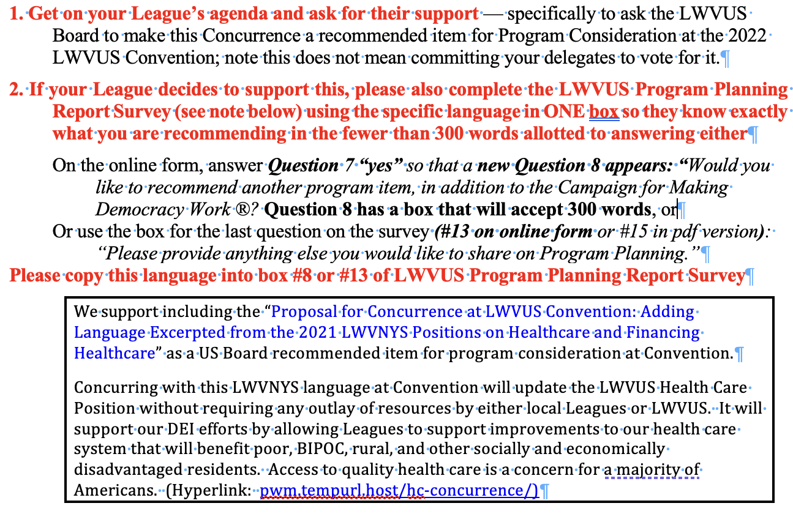
What are Leagues being asked to do:
pwm.tempurl.host/hc-concurrence/
5
Notes:
All our concurrence materials are now online — and will be there for the next 5 months. The URL to access them is now in the chat, and we will circle back to any specific questions you have at the end of this presentation.

Slide 6
Concurrence Process
The wording of a proposed concurrence cannot be changed (no wordsmithing)
Some trusted League entity must have conducted a study and reached consensus on a position
The study materials from the study should be available to League delegates considering the concurrence
Once adopted, the League board will incorporate the new wording into the existing position (if there is one). Otherwise, it becomes a new position
Concurrences done at Convention save Leagues time and resources
6
Notes:
Concurrence is a very specific League process. It depends on some League entity doing a study and reaching a position.
Other Leagues can then agree or concur with that position. That is why the wording can’t be changed.
Concurring with another League’s position allows you to have a position without spending the time and resources to conduct a study

Slide 7
Current LWVUS Position on Healthcare
Was adopted in 1993 and updated, by concurrence in 2016, by adding a section on Behavioral Health
Needs updating due to changes in our healthcare system over the past 29 years
Can be updated (using the concurrence process) by adding excerpts from the LWVNYS 2021 Healthcare Positions
7
Notes:
Transition: so what has changed in the past 29 years? Let’s look at how US HC has become more inequitable — by costing more, by having fewer insured, and by having relatively worse health outcomes than peer countries with more equitable, affordable access — and who pay less in taxes for their HC than we do
A lot has changed since the main part of the national Healthcare position was adopted in 1993.
And the NY League positions – there were two, one on Healthcare in general and one on the Financing of Healthcare – were based on studies and updates that dated from 1985 and were last revised in 1991. A section on advance directives was added in 1999.
The easy way to update the national position is to concur at convention with a position – in this case excerpts from the 2021 New York State positions.
We can’t change the language of the existing national position without a study, but through concurrence, we can add to it.
So how has healthcare and its delivery system changed since 1993

Slide 8
What has changed since 1993?
Fewer Americans with affordable access
Healthcare increasingly expensive: for families
Healthcare increasingly expensive: for taxpayers
Public health worsening
US outcomes lagging peer counties
Disparities among marginalized Americans worse
8
Notes:
US GDP grew 114% between 1999 and 2018 … HC costs grew 186% and now total $3.7 Trillion/year
You can’t have universal access if healthcare isn’t affordable.
There have been great advances in medical care. Pharmacological treatments have become more effective in curing, treating or delaying the onset of many serious conditions — even making previously lethal chronic diseases manageable.
Complicated surgeries have become more successful – think heart transplants and now routine joint replacements. But costs have exploded — creating inequities in access.
Families spend way more on healthcare than they did in the 90’s. And many employers no longer offer health insurance for their employees. Others require increased employee contributions and offer plans with lower premiums, narrower networks, and increased cost-sharing — reducing access for even middle-class Americans.
And taxpayers are paying more for healthcare, too – providing healthcare for government employees, the indigent, the incarcerated, and with pricier privatized care for seniors, long-term dialysis patients, veterans, and others.
Americans are now paying twice as much for healthcare per capita as Europeans — we’re paying more in TAXES for HC than they pay for ALL their HC. And they cover everyone. In 1990, healthcare expenditures were 12% of our country’s GDP, now they’re 20%.
But on important measures we are not getting healthier, and access now depends much more on where you live, how much you make, and what kind of work you do.
Today, fewer Americans can afford access to healthcare

Slide 9
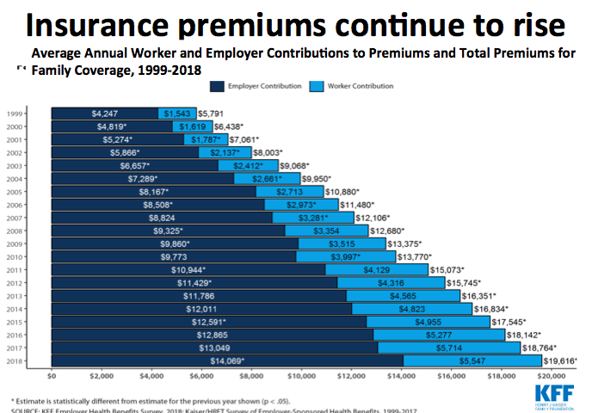
Health insurance premiums have more than tripled in <20 years …
9
Notes:
The cost of health insurance premiums has tripled over the past 20 years — from an average cost of just under $6K to just over $19K with bigger shares paid by workers
Employers are also choosing plans with greater cost-sharing
But having them triple over the past 20 years isn’t the worst part … it’s the dramatically increased cost-sharing that make Health insurance prohibitive

Slide 10
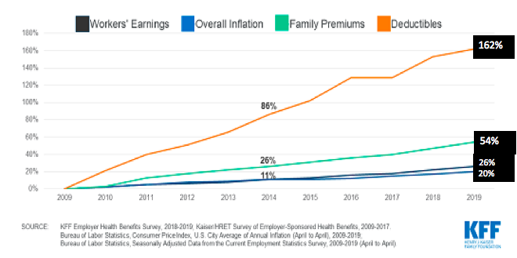
Employers shift costs to workers: deductibles are up 4x faster than premiums, 8x faster than wages
10
Notes:
Healthcare has become prohibitively expensive
The bottom blue and black lines — inflation and wages —have gone up 26% The green line is premiums … up 54% And the orange is cost-sharing ... which has increased 162% —8x faster than wages
This orange line —deductibles and co-pays, and everything you pay after you’ve paid premiums,
plays a HUGE role in reducing American access to healthcare—
it‘s a cost-control method lauded in the 1980s and 90‘s which raises total HC costs and reduces public health.
It‘s why the Concurrence seeks to add ... “evidenced based“ cost controls to the National League position
But doesn‘t job-based insurance offer equitable access?

Slide 11
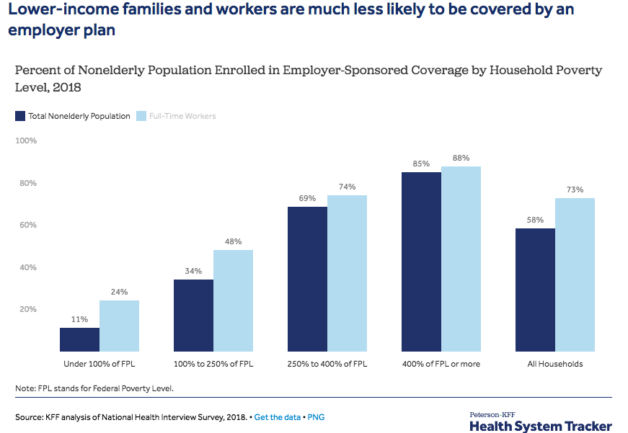
Job-based insurance disproportionately benefits better off — only 40% of private-sector employees covered
11
Lower wages, fewer benefits
Notes:
Poor people don’t’ get health insurance in their jobs … employment gives insurance disproportionately to the better off
More high-wage workers get health benefits than lower-wage workers
Let me use some NYS examples to illustrate FPL in this chart in NYS 90% of families making under $50K/year get NO health benefits... but 85% of families earning more than $200K DO get benefits Is this equitable access?
So why do we believe Americans depend on worker health benefits? Well, in 1991, when the the national League was studying HC, more than 77% of private-sector jobs had health insurance – now only 40% do.
AND it‘s dropping every year: newly-hired workers don‘t get health benefits. nor do gig workers — Uber, Lyft, GrubHub, InstaCart are speeding this trend.
Healthcare access today is far less equitable than 30 years ago— what‘s happened to public health?

Slide 12
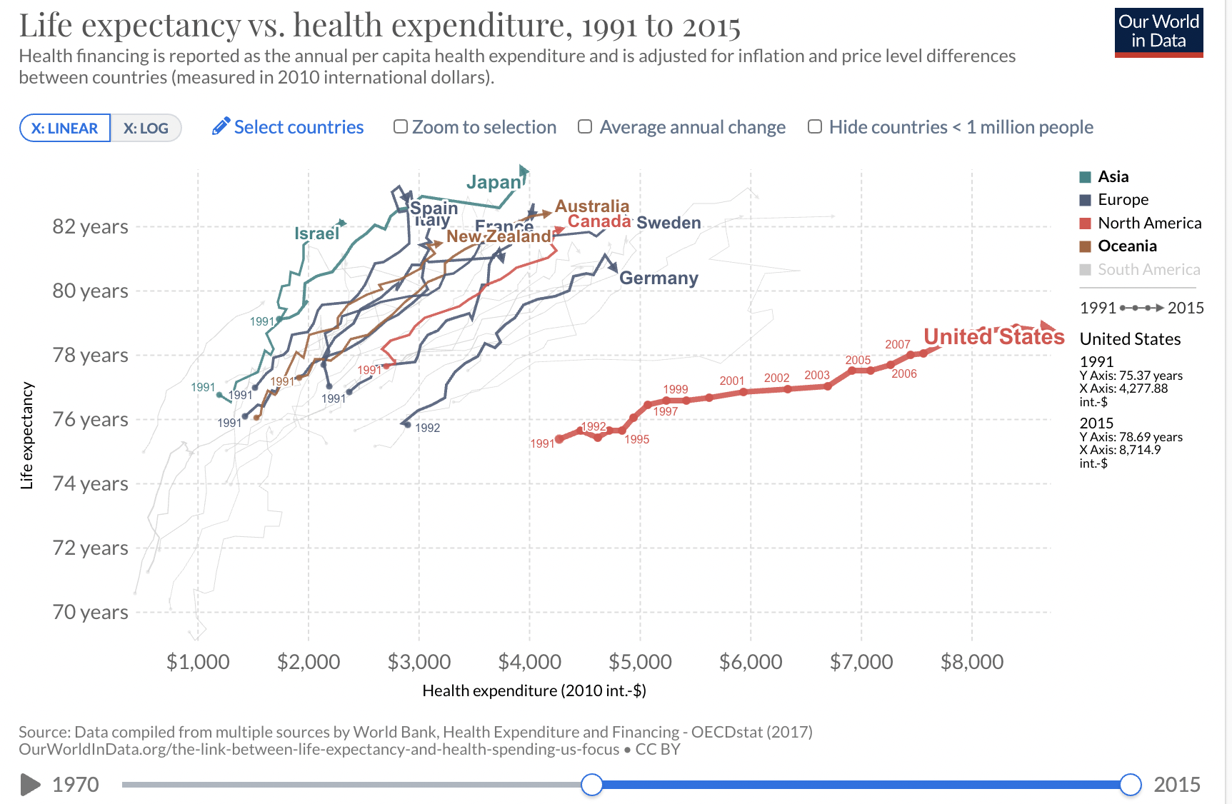
US Life Expectancy trails peers, with flattening growth relative to peers since 1993
12
https://ourworldindata.org/the-link-between-life-expectancy-and-health-spending-us-focus
Notes:
This slide‘s complicated... So just note that the red line is lower and flatter than the other lines ... .
The red line shows the US as an outlier
It’s flatter because American life expectancy lengthened 3 years over the past quarter-century— while peers with universal healthcare lived 4 and a half to 6 yrs longer — and cost half as much
Treating healthcare like a market harms public health …

Slide 13
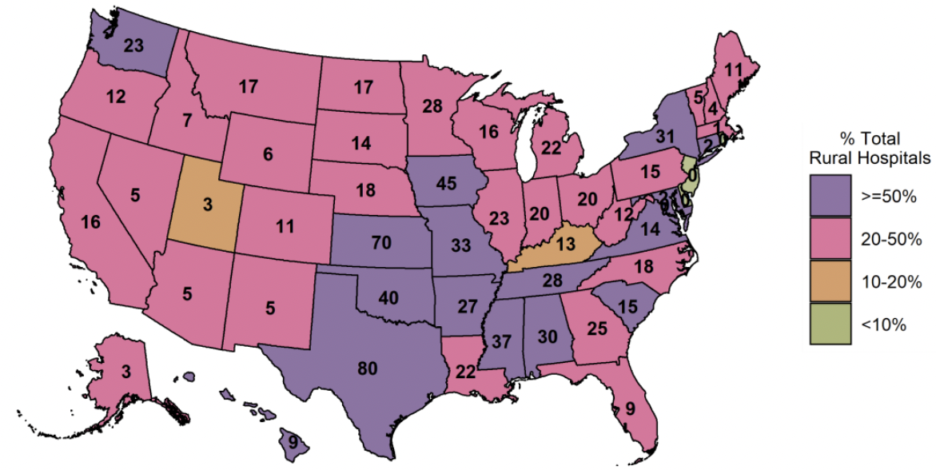
Between 2005 and 2020: 166 rural hospitals closed 2021: 40% of nation’s rural hospitals are at risk
Cumulative rural hospital closures since 2005
13
900 rural hospitals (40%) at risk of closing
https://www.shepscenter.unc.edu/programs-projects/rural-health/rural-hospital-closures/
Accessed October 21, 2020 https://pnhp.org/kitchen-table-campaign-rural-health-care/
https://ruralhospitals.chqpr.org/downloads/Rural_Hospitals_at_Risk_of_Closing.pdf
Notes:
You’ve likely heard how many hospitals across the country have had to close or been threatened by closing over the past year, despite Covid — most of these have have been public hospitals in cities or rural hospitals that serve rural residents, many of whom are on Medicaid or Medicare.
NYS has seen fewer hospitals close than states that failed to expand Medicaid and states with less a robust healthcare insurance safety net, but NYS has seen scores of hospitals merge into ever larger hospital corporations.
For –profit Insurance also plays a role in shuttering hospital beds and hospitals, particularly in rural areas…
The number of hospital beds in the US has dropped 60% since 1975 , despite our population increasing by 50% — our for-profit healthcare system regards beds as costs, not public health assets
Across the country, 166 rural hospitals have closed over the past 15 years. 47 filed for bankruptcy just in 2020.
40% of the rest are in dire straits In the map at the bottom, purple means that more than half that state’s rural hospitals could close soon; fuschia means 20-50% are at risk.
But there’s worse news, hospitals that stay open are cutting services, like behavioral health (substance abuse), and maternity wards

Slide 14
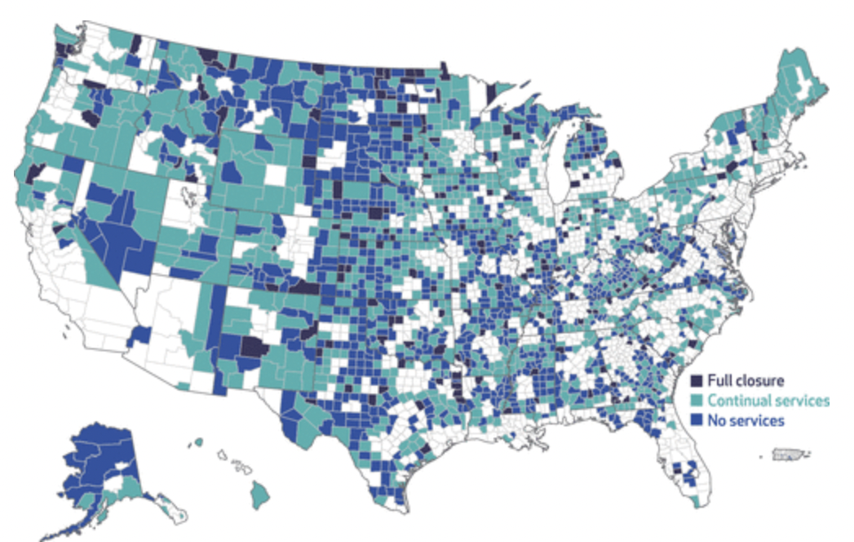
2004–2014: US counties with hospital obstetric services saw even more close or curtail services
14
https://www.healthaffairs.org/doi/10.1377/hlthaff.2017.0338
Notes:
Worse even than hospitals closing, the for-profit system rewards market power so you’ve likely noticed how many small hospitals are being acquired into giant hospital “systems.” Unlike the previous map, the hospital doesn’t close but it often curtails or closes its obstetric services … note how very many of the 3000 counties in the US are black, dark blue, or teal. No wonder the March of Dimes is sounding the alarm about maternity deserts … .and when maternity wards close, ob-gyn specialists depart … and prenatal and postnatal care suffers.
When maternity wards close, obstetricians and mid-wives relocate.
On this map, the 90 counties marked in black show where hospitals closed.
The blue shows counties where hospitals shut down obstetric services — no maternity wards, no obstetricians, no mid-wives.
What happens when Americans live 40 miles to 200 miles from the nearest ob-gyn facility?
So what does that mean for the health outcomes of American mothers and infants?

Slide 15
Maternal mortality is decreasing outside the US — but rising in the US for 2 decades
15
"Global, regional, and national levels of maternal mortality, 1990–2015: a systematic analysis for the Global Burden of Disease Study 2015," The Lancet. Only data for 1990, 2000 and 2015 was made available in the journal.
Notes:
The red line shows the US trend, the black lines show a dozen peers BUT, according to the WHO, out of 183 countries, 157 countries decreased their maternal mortality between 2000 and 2013 — when the US rate rose, steeply, 157 black lines went the other direction
Of the 31 OECD countries, only Mexico has worse maternal mortality.
Black mothers die at 3 or more times the rate of white mothers.
Rural areas are 2 to 3 times worse than urban areas
Our urban areas are 2-3 times worse than Europe’s
Thirty years ago, too many American mothers died of pregnancy-related reasons. Since then, many countries have halved their death rates — ours have almost doubled.

Slide 16
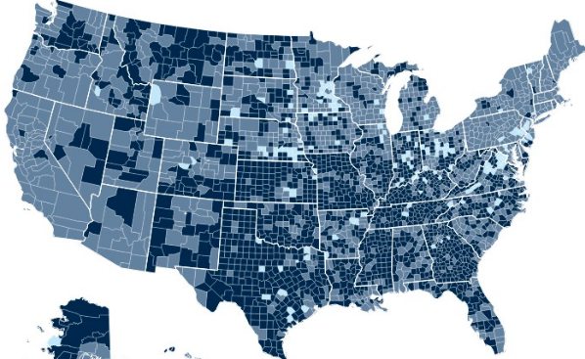
Primary Care Doctor Shortage by County
16
None of county is shortage
Part of county is shortage
Whole county is shortage
Source: data.HRSA.gov, Oct 2019
Notes:
This map shows all 3000 US counties,— the darker coloring shows counties with worse shortages of primary care doctors — and dark blue means NO primary care doctor.
Primary care isn’t profitable. It’s reimbursed at lower rates. Medical schools discourage students from entering primary care.
Yet the “family doctor” who knows you and your medical history is the backbone of good care — or was, thirty years ago.
Across the 3000 US counties, only the pale blue counties have enough family doctors.
Looking at the entire US map, it’s frightening how our rich country — especially rural and poor areas —lacks primary care doctors.
And note: much of rural America lacks broadband … so telemedicine isn’t an option. This is why we’re asking supporters of our healthcare concurrence to also support the Digital Equity concurrence.
Now that we’ve set the stage for why a HC position adopted 30 years ago might need updating, let’s discuss the NYS Study and the proposed concurrence
I could show you similar maps of hospital beds. In NYS, for example, we had 40% more hospital beds in 2000 than we do now. No wonder the pandemic is close to breaking our healthcare system.
Compared to other countries, we have far fewer hospital beds ., only 2.8 beds per 1,000 people — France has more than double that; South Korea has more than 4 times as many.
Manhattan — the most densely populated county in the US, and one of most densely populated areas in the world — reveals the wealth of its neighborhoods by their density of healthcare providers. Particularly, the Upper East Side with 168K people/sq mile — has a dozen prestigious hospitals, and doctors’ offices on almost every block. Life expectancy in those ZIP codes exceeds life expectancy a few blocks north by 11 years.
It’s a case study for how today’s for-profit funding of healthcare concentrates resources to maximize profitable customers
Over the past 3 decades have American HC has become increasingly unaffordable for all but high-income Americans, — medical debt triggers 2/3 of personal bankruptcies and most Americans will be in medical debt at some point in their lives
Worse, American public health has gotten worse, relative to residents of our developed country peers — life expectancy, maternal and infant mortality, the health of those with chronic conditions.
Now that we’ve set the stage for why a HC position adopted 30 years ago might need updating, let’s discuss what prompted the NYS Study Committee and what it did.

Slide 17
How did LWVNYS update its Healthcare and Healthcare Financing Positions?
LWVNYS Convention 2019 gave charge to update its Financing of Healthcare position
Healthcare Update Committee (HCUC), formed in Fall of 2019, began meeting
HCUC decided that it made sense to also update the Healthcare Position
By Fall of 2020 the HCUC had developed extensive study materials and drafted new Positions, and distributed to local Leagues for their consensus
New Positions adopted, nearly unanimous, Mar 2021
17
Notes:
n 2019, there was much public discussion about adopting a NY State single-payer system, so the New York State Board recommended that the 2019 Convention update our position on Financing of Healthcare.
The board wanted to ensure member support and understanding of the existing position and its consequences.
By the fall of 2019, a committee was formed consisting of seven members from various regions of the state, including three Ph.Ds, and four with experience in the delivery of Healthcare.
We compiled and summarized health policy sources and then culled them down to 50 footnoted pages of study materials, which included the two rewritten positions.
In late fall of 2020, we sent the positions and study materials to local Leagues for Concurrence by March of 2021.
Of the 31 Leagues who reported their discussions, all concurred with the Healthcare Position and all but one concurred with the Financing Position.

Slide 18
Current LWVUS Goals for Healthcare
Universal — Equitable Access
“For all U.S. residents”
No rationing by income, gender, race/ethnicity, pre-existing conditions, where you live …
Equitable Quality
Equitable treatment, including prevention of disease, health promotion and education
Equitable distribution of services
Affordable (& Feasible)
For all: patients, taxpayers, providers …
“Financed through general taxes” [progressive] not “individual insurance premiums” [regressive]
18
Notes:
In deciding which language from the New York State positions to include in the concurrence statement, our HCUC — which is the group bringing this concurrence forward — looked at what was important to add to the US position, removing redundant and state-specific language from what is being offered.
When we look at the goals in the national position, they call for every resident of the US to have access to a basic level of quality care, distributed equitably, at a reasonable cost to patients, individuals, and taxpayers.
As we go through these points, we have put national League’s wording in green and New York’s in purple so that you can clearly see what we propose to add

Slide 19
Highlights of Proposed Additions from NYS
Protecting the vulnerable — and public health
Expanded delivery options (e.g., telemedicine) while providing “standard of care” tests and treatments
Separating healthcare access from employment status
“Safe staffing”— for staff & patient safety
Patients, family, providers decide health care
Cost-controls require evidence of reduced total costs and not exacerbate disparities in outcomes
Single-payer concept as viable, desirable for achieving LWV goals: affordable, equitable, universal HC
States can enact universal HC until Congress does
Regular assessment and transparent administration
19
Notes:
Here’s what we want to add: protecting the vulnerable and, by doing that, protecting public health.
The pandemic has certainly shown us that we need to add telemedicine and other innovative delivery settings to our repertoire and that we need to separate healthcare access from employment status.
We’d add safe staffing which is defined as a minimum number of staff with specified training required to care for a specified number of patients at specified risk and needing particular kinds of care. To keep patients safe — and to keep staff safe.
We spell out the right of patients to make their own healthcare decisions in consultation with whomever they choose.
We call for cost controls to be evidence based – to show that they actually reduce costs for the whole system and that they don’t increase disparities of outcome
We specifically add that the single-payer concept is viable and desirable for achieving the League’s national goals of affordable, equitable, universal healthcare and
that States can act as laboratories of democracy by piloting state-based programs of universal HC until such time that a federal program is enacted.
Additionally, we also call for regular assessment and transparent administration of the healthcare system.

Slide 20
GOALS: The League of Women Voters of the United States believes that a basic level of quality health care at an affordable cost should be available to all U.S. residents. Other U.S. health care policy goals should include the equitable distribution of services, efficient and economical delivery of care, advancement of medical research and technology, and a reasonable total national expenditure level for health care.
US Current Position: Goals
20
Notes:
This slide shows you the actual wording of the goals in the existing national Healthcare Position

Slide 21
The League supports regulatory incentives to encourage the development of cost-effective alternative ways of delivering and paying for health care. Delivery programs may take place in a variety of settings, including the home and online, and must provide quality care, meaning consistent with “standard of care” guidelines, by trained and licensed personnel, staffed adequately to ensure their own and patient safety. As public health crises increasingly reveal, a health program should protect the health of its most vulnerable populations, urban and rural, in order to protect the health of everyone. In addition, all programs should be evaluated regularly. Decisions on medical procedures that would prolong life should be made jointly by patient, family, and physician. Patient decisions, including those made prior to need, should be respected.
Proposed NYS Additions: GOALS
Expand delivery options
21
Safe staffing
Protect the vulnerable to protect all
Who makes decisions
Notes:
This slide shows you the actual wording of the language from the New York League’s positions that would be added to the existing national Healthcare Position.
It will be up to the national board to decide where to add this new language. I’m going to read it to you:
GOALS
The League supports regulatory incentives to encourage the development of cost-effective alternative ways of delivering and paying for health care.
Delivery programs may take place in a variety of settings, including the home and online, and must provide quality care,
meaning consistent with “standard of care” guidelines, by trained and licensed personnel, staffed adequately to ensure their own and patient safety.
As public health crises increasingly reveal, a health program should protect the health of its most vulnerable populations, urban and rural, in order to protect the health of everyone. In addition, all programs should be evaluated regularly.
Decisions on medical procedures that would prolong life should be made jointly by patient, family, and physician. Patient decisions, including those made prior to need, should be respected.

Slide 22
The League favors a national health insurance plan financed through general taxes in place of individual insurance premiums. As the United States moves toward a national health insurance plan, an employer-based system of health care reform that provides universal access is acceptable to the League. The League supports administration of the U.S. health care system either by a combination of the private and public sectors or by a combination of federal, state, and/or regional government agencies. The League is opposed to a strictly private market-based model of financing the health care system. The League also is opposed to the administration of the health care system solely by the private sector or the states.
US Current Position: FINANCING & ADMINISTRATION
Implicit single-payer
Job-based as interim step
22
Multi-level admin
Oppose private-sector alone or state alone
Notes:
This slide shows the current wording of the national position as it relates to the financing of healthcare.
You will note that the current wording doesn’t actually use the term “single-payer” — although by calling for a national health insurance system financed through general taxes that provides universal access, it implicitly supports single-payer. Just as an aside, I want to point out that single-payer systems come in two main styles: one like the VA
where it is publicly funded and the providers are employees of the system – and one like Medicare where it is publicly funded but the medical professionals and hospitals are independent agents. The doctors and nurses work in private practice, partnerships, or as employees of private corporations… perhaps reimbursed by public funds but not employed by the government “
And the call for a transition from employment-based insurance to universal access is a call for the unemployed, the disabled, the young and those whose employers don’t provide health insurance to all have access to healthcare.

Slide 23
The League supports the single-payer concept as a viable and desirable approach to implementing League positions on equitable access, affordability, and financial feasibility. In any proposed healthcare financing system, the League favors health insurance access independent of employment status. Although the League prefers a healthcare financing system that includes all residents of the United States, in the absence of a federal program that achieves the goals of universal, affordable access to essential health services, the League supports healthcare programs financed by states which include continuation of federal funding and comply with League principles.
Proposed NYS Additions:
FINANCING & ADMINISTRATION
Explicit single-payer
Separating insurance access from employment
23
Until Federal HC program enacted, support State HC programs
Notes:
This shows financing excerpts from the New York positions that would be added to the national one. The new position would make support for a single-payer system more explicit and provide the rationale.
It would strengthen the concept of separating health coverage from employment.
We all recognize that Americans enjoy their mobility and, optimally, you’d have the same universal healthcare access regardless of the state you live in, with no gaps or waiting periods after you move
But this section recognizes the role individual states have traditionally played in piloting critical legislation — from seat belts to gay marriage, from drug laws to environmental protections.
It also recognizes the role the Canadian province of Saskatchewan played in 1962, demonstrating the feasibility of its single-payer healthcare, and prompting all of Canada to follow within a decade.
It also calls for continued federal funding as a necessary part of the funding mix before the League will support any state bill

Slide 24
US Current Position: COST CONTROL
The League believes that efficient and economical delivery of care can be enhanced by such cost control methods as:
the reduction of administrative costs,
regional planning for the allocation of personnel, facilities, and equipment,
the establishment of maximum levels of public reimbursement to providers,
Malpractice reform,
the use of managed care,
utilization review of treatment,
mandatory second opinions before surgery or extensive treatment,
consumer accountability through deductibles and copayments.
24
Notes:
Some of the cost control methods listed in the national position – like mandatory second opinions and cost-sharing – have raised total system costs.
Remember, a concurrence cannot revise the wording of an existing position, but it can add new wording that is not in opposition. Everything in the NYS position was reviewed with this in mind

Slide 25
Specific cost-control methods should reflect the most credible, evidence-based research available on how healthcare financing policy affects Methods used should not exacerbate disparities in health outcomes among marginalized residents.
Proposed NYS Additions: COST CONTROL
Evidence of equitable access, quality, less cost
equitable access to healthcare,
overall quality of care for individuals and populations,
and total system costs of healthcare and its administration.
25
Shall not exacerbate disparities in outcomes
Up to 30% of costs
Reduction of administrative costs — both for the insurance program and for providers,
Negotiated volume discounts for pharmaceuticals and durable medical equipment to bring prices closer to inter- national levels — or importing of same to reduce costs ,
Evidence-based treatment protocols and drug formularies that include cost/benefit assessments of medical value,
Up to 30-60% savings
Notes:
This slide and the next one would add to the national position on cost control.
Given the much-faster-than-inflation increase in healthcare costs since 1993 when the national Healthcare position was adopted, we in NYS require that “specific cost-control methods should reflect the most credible, evidence-based research available on how healthcare financing policy affects a) equitable access to healthcare, b) overall quality of care for individuals and populations, and c) total system costs of healthcare and its administration. Methods used should not exacerbate disparities in health outcomes among marginalized residents.”
The League has always called for universal access to healthcare, but our recent emphasis on Diversity, Equity and Inclusion requires us to pay more attention to the way that certain cost control measures unfairly impact marginalized communities –
and by that we mean rural residents, people living in urban healthcare deserts, people who identify as non-binary or LGBTQ, non-English speakers, the incarcerated, the undocumented as well as people of color and specific ethnicities.
Reduction of administrative costs is a key benefit in a single-payer system, since it eliminates the need for providers to employ a brigade of billers and coders to keep up with the requirements of multiple insurers,
just as it eliminates the brigade of insurance administrators whose jobs depend on denying and delaying care
and we have the experience of single-payer systems like the VA and Medicare where administrative costs are less than 3% of total costs – not the 15-20% or even 30% of for-profit insurers.
Negotiating volume discounts with pharmaceutical companies would likely achieve the 50% savings achieved by the Veteran’s Administration for 6M patients.

Slide 26
Proposed NYS Additions: COST CONTROL, contd.
Errors
Tort $ Premiums
Malpractice reforms designed both to compensate patients for medical errors and to avoid future errors by encouraging robust quality improvement processes (at individual and systemic levels) and open communications with patients
Investment in well-care — such as prevention, family planning, patient education, primary care — to increase health and reduce preventable adverse health events/expenditures
Investment in maternal/infant care, chronic disease management, and behavioral healthcare
Provision for short-term and long-term home-care services to reduce institutionalization
26
Well-care saves $ over disease-care
Better outcomes, fewer $
Notes:
These cost-control methods reduce the overall costs of healthcare by reducing harm,
such as reducing malpractice errors by systematic quality improvements — or preventing serious disease with early intervention and regular health education.
Today preventive care isn’t profitable for private insurers: paying for preventive care for patients who change insurers represents costs but no savings. When everyone in a state is in the same insurance pool, preventive care reduces the total cost for that person and reduces the overall system cost.
Similarly, most people who need assistance with daily tasks prefer to remain in their own home, if possible, and paying for short and long-term homecare is usually less expensive than institutionalization because the patient continues to pay for their own housing and food

Slide 27
The League supports public input as integral to the process for determining healthcare coverage and funding. To participate in public discussion of health policy and to share effectively in making policy decisions, residents must be provided with information on the healthcare system and on the implications of health policy decisions. .
Proposed NYS Additions: PUBLIC PARTICIPATION
Current US Position: [silent]
Wider range of perspectives informs better decisions
27
Transparency
Notes:
This requirement for public participation in healthcare policy just makes explicit the League’s longstanding support for public input into all government decisions

Slide 28
Highlights of Proposed Additions from NYS
Protecting the vulnerable — and public health
Expanded delivery options (e.g., telemedicine) while providing “standard of care” tests and treatments
Separating healthcare access from employment status
“Safe staffing”— for staff & patient safety
Patients, family, providers decide health care
Cost-controls require evidence of reduced total costs and not exacerbate disparities in outcomes
Single-payer concept as viable, desirable for achieving LWV goals: affordable, equitable, universal HC
States can enact universal HC until Congress does
Regular assessment and transparent administration
28
Notes:
This is the same page you saw before — legislation that encompasses them will reduce cost, improve public health, and make both access and outcomes more equitable.
What has the pandemic taught us about our public health?

Slide 29
2019: Marginalized Americans (of color, rural, poor) got less healthcare, died 7-9 years younger than G7
G7 Average 81.9 years
2019
29
78.5
74.9
71.8
(White Non-Hispanic)
Black
Native
American
Sources: NCHS, HIS. OECD, CDC
Other G7 nations: Canada, France, Germany, Italy, Japan, UK
Notes:
That white dotted line shows the G7 average life expectancy BEFORE the pandemic — our 6 peers outlived even White Americans by 3&a half years
And Whites outlived Blacks by more than 3&a half years; who outlived Native Americans by yet another 3 yrs
The pandemic has worsened our health disparities

Slide 30
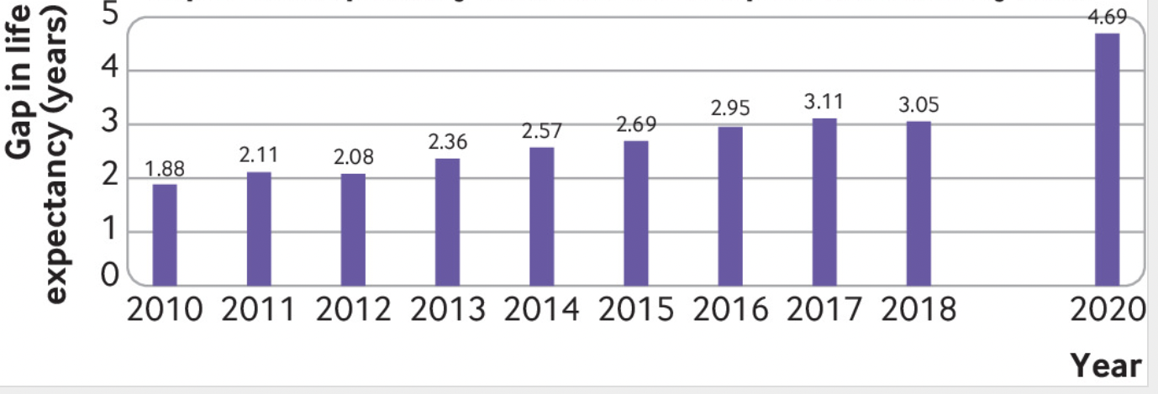
Pandemic: US healthcare inequities became more visible and exacerbated relative to peer countries
US life expectancy trailed peers before Covid, but the gap worsened by 50% in 2020*
4.7 yr
3.5 yr
30
1.9 yr gap
* Russia and the US, losing 2 years of life expectancy, ranked worst and second worst among 37 countries; coming in third to fifth worst were Bulgaria, Lithuania, and Poland. Only NZ, Taiwan, and Norway increased their life expectancy. BMJ Nov 2021: https://www.bmj.com/content/375/bmj-2021-066768
BMJ 2021; 373 doi: (Published 24 June 2021) https://www.bmj.com/content/373/bmj.n1343
Notes:
These columns show the worsening “gap” in American longevity — we died 2 years younger than peers in 2010 —and 3 years younger in 2018
In 2020, the gap rose 50% to 4.7 years.
On average, this is bad … for the marginalized among us, it’s been catastrophic

Slide 31
Covid sharply reduced Latinx (3 yrs) & Black (2.9 yrs) life expectancy — White Americans lost (1.2 yrs)
2
As of Nov 2021
81.8
31
78.8
78.8
77.6
74.7
71.8
Hispanic
(White Non-Hispanic)
Black
Sources: https://www.cdc.gov/nchs/data/nvsr/nvsr70/NVSR70-12.pdf
https://www.cdc.gov/nchs/data/vsrr/vsrr015-508.pdf
Notes:
Life expectancy in France fell 7 months, in Germany 3 months.
American whites lost 14 months, but Latinx and Blacks lost 3 years … American Blacks now die almost ten years younger than G6 residents
Harlem, the South Bronx, and East Bronx lost ½% to 1% of their residents — it’s like having 3.3 Million Americans die
— Covid has killed Black and Indigenous People— at 3-to-5 times the rate of Whites — and at much earlier ages.
So what caused most deaths besides Covid?

Slide 32
The Five Leading Causes of Death (All Americans)
Heart Disease
32
Cancer
Unintentional Injuries*
Lower Respiratory Diseases
Strokes
* Do not include homicide and suicide
Potentially Excess Deaths from the Five Leading Causes of Death in Metropolitan and Nonmetropolitan Counties — United States, 2010–2017, Centers for Disease Control, November 8, 2019
https://www.cdc.gov/mmwr/volumes/68/ss/ss6810a1.htm?s_cid=ss6810a1_e&deliveryName=USCDC_921-DM12720 2017 data
Notes:
The five leading causes of death are the same for all Americans, urban and rural, black and white

Slide 33
Black Americans have higher rates of PREVENTABLE DEATH from the five leading causes of death
30% more: 15 mos
Heart Disease
33
70% more: 8.6 mos
Cancer
65% more
Unintentional Injuries
Triple
Lower Respiratory Diseases
70% more: 5.7 mos
Strokes
https://public.tableau.com/profile/macarena.garcia#!/vizhome/potentially_excess_deaths_2010_2017/excessdeathsstoryboard
Notes:
But more Black Americans die — and die faster. At triple the rate of Whites for respiratory diseases and 70% higher for cancer and strokes
But, lest you think the rural HC disparities are only with the chronically ill, they also appear in the young and apparently healthy...

Slide 34
Black & Rural Americans have higher rates of PREVENTABLE DEATH from the five leading causes
Blacks
Rural
30% more:15 mos
Heart Disease
2.5 Times
34
70% more: 8.6 mos
Cancer
Quadruple
65% more —
Unintentional Injuries
50% more
Triple
Lower Respiratory Diseases
Triple
70% more: 5.7 mos
Strokes
Double
https://public.tableau.com/profile/macarena.garcia#!/vizhome/potentially_excess_deaths_2010_2017/excessdeathsstoryboard
Notes:
And more Rural Americans die— and die faster. For cancer, it’s 4 times the rate …

Slide 35
Black & Rural Americans have higher rates PREVENTABLE DEATH from the five leading causes
Blacks
Rural
30% more:15 mos
Heart Disease
2.5 Times
35
86% are amenable to medical prevention & treatment
70% more: 8.6 mos
Cancer
Quadruple
65% more —
Unintentional Injuries
50% more
Triple
Lower Respiratory Diseases
Triple
70% more: 5.7 mos
Strokes
Double
https://public.tableau.com/profile/macarena.garcia#!/vizhome/potentially_excess_deaths_2010_2017/excessdeathsstoryboard
Notes:
Yet 86% of these deaths are preventable — 86% … these are people’s lives.
Americans aren’t getting what people in peer countries get routinely: prevention, treatment, affordable care
Americans don’t have family doctors. They live too far from doctors.
And they fear getting sick — it costs too much: 2/3 of bankruptcies are caused by medical debt.
I find these differences astonishing — and tragic
Rural residents are not benefiting from medical interventions that are decades old
A rural mom in NYS is 60% more likely to die.
Rural infants suffer similarly tragic higher death rates.
Moving on, we all know that life expectancy depends on nutrition …
Well, a third of rural seniors have no teeth – almost 50% more than urban seniors — and Medicare does not pay for most dental procedures … not for dentures, not for implants.
A recent study concluded that the risk of death tripled for people with no teeth over those with 20 or more — and doubled for those who had lost some teeth but not all.
Also note there are twice as many practicing dentists in urban areas as in rural areas — and those fewer dentists are spread over larger distances. For rural areas, we’re talking fewer than one dentist per county.
It’s no wonder that 70% of Americans suffering dental problems haven’t seen a dentist in a year?
Also: hearing. Medicare doesn’t pay for hearing aids, rural areas have few specialists, and 70% of adults need hearing aids go without.
These seniors are at higher risk of depression, dementia and falls — which, as we know, for seniors, too often lead to death.

Slide 36
Life expectancy corelates with ZIP Code (by county, colors show a 12-year difference)
36
Notes:
For Americans, your ZIP code predicts how long you live.
As we’ve seen, rural Americans have less access to healthcare — fewer hospitals, fewer primary care doctors, less insurance —and are likely to die preventable deaths. Lack of access to HC kills.
Ditto for Black and Indigenous Americans — and ditto to no access even to telemedicine.
As an aside, the states which did NOT expand Medicaid represent more than half of Black Americans without insurance
Contrast the Upper East Side of Manhattan, one of America’s most dense residential areas, with 186K people/sq mile; it’s rich with hospitals and doctors’ offices, and workers with health benefits, and has one of the highest life-expectancies in the US … indeed in the world.
It’s also a short walk from Harlem where life expectancy is 11 years less (similar to that of Mexico or Sri Lanka) and has few doctors or hospitals. It’s where many of NY’s essential workers live, ..
people doing essential jobs who must interact daily with the public — essential workers with no sick leave and no healthcare — and no choices.
This is why the American College of Physicians recommended rolling out covid vaccinations by zip code, not age.
Before we end, I’d like to add that Covid taught us about viruses riding subways, trucks, and planes, and inevitably reaching even remote Alaskan villages.
Ease of travel is one obvious reason why the US has experienced more epidemics over the past decade than anywhere else globally.
The WHO, which has documented about 200 epidemics per year recently, notes another reason the US, despite its wealth, is seeing such devastation: The most difficult to control epidemics occur in countries with poor public health and among populations without equitable access to primary care.
The League of Women Voters and the WHO have similar goals, but our League needs to become more explicit in our advocacy — hence the need for this concurrence — I’d like to end with a quote from the 2018 WHO Handbook on Epidemics:

Slide 37
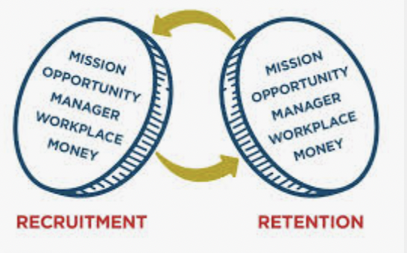
Pandemics: to reduce them, to end them
Universal health coverage
and health security are
two sides of the same coin.
Heads
Tails
37
Universal
Healthcare
Health
Security
Ultimately, the absence of universal health coverage [for the most vulnerable people] is the greatest threat
to health security [for everyone].
Dr Tedros Adhanom Ghebreyesus
Director-General, World Health Organization
(WHO 2018 handbook) https://www.who.int/emergencies/diseases/managing-epidemics-interactive.pdf
Notes:
Universal health — and health security — are two sides of the same coin.
Ultimately, the absence of universal health coverage [for our most vulnerable people] is the greatest threat to health security [for everyone].
The League’s advocacy for equitable access to healthcare will certainly benefit marginalized Americans, equally certainly it will benefit vulnerable Americans — which means every one of us.
As of January 1, 2022, in US 55M cases and 825,000 deaths not counting est 15+M long covid (30%?)
Worldwide: 290M cases and 5.5M deaths … not counting long covid
40% reduction in hospital beds since 1975: https://www.cdc.gov/nchs/data/hus/2017/089.pdf

Slide 38
<pwm.tempurl.host/hc-concurrence/>
Learn more: Healthcare Concurrence URL:
Health Care Concurrence Statement
Memo on Concurrence
Leagues that support the Concurrence
How to support the Concurrence on the LWV ProgPlan online survey
LWVNY HCUC Study Materials
Pro/Con’s
US Position & NYS Positions & More
Link to Digital Equity Concurrence (on LWVNM website)
38
Notes:
This pptx will be made available, on request. But all of our concurrence materials will be online for the next five months, being updated as we go.
You will find directions for filling out the National Program Planning committee’s online survey (with links to the survey) so your League can support getting the concurrence discussed at Convention.
And, while of course, we hope your delegates vote to support adopting it by concurrence, your support on the survey doesn’t commit them either way.
You can also find a link to the Digital Equity Concurrence materials, and the most up-to-date list of Leagues who have already signed on: right now it’s 39 Leagues from 13 States — about 5% of the Leagues in the US, but we’d really like 10%

Slide 39
What are Leagues being asked to do:
pwm.tempurl.host/hc-concurrence/
39
Notes:
Go to the HC Concurrence URL and follow instructions for asking LWVUS Program Planning Committee to put the concurrence on the agenda for discussion at the convention
Just as a reminder, this is what we are asking you to do so that this healthcare concurrence can be discussed and voted on at Convention.

Slide 40
Thank you Questions?
40
Notes:
We want to thank you for your time today … Questions?

Slide 42
Proposed Concurrence Statement
GOALS
The League supports regulatory incentives to encourage the development of cost-effective alternative ways of delivering and paying for health care. Delivery programs may take place in a variety of settings, including the home and online, and must provide quality care, meaning consistent with “standard of care” guidelines, by trained and licensed personnel, staffed adequately to ensure their own and patient safety.
As public health crises increasingly reveal, a health program should protect the health of its most vulnerable populations, urban and rural, in order to protect the health of everyone. In addition, all programs should be evaluated regularly.
Decisions on medical procedures that would prolong life should be made jointly by patient, family, and physician. Patient decisions, including those made prior to need, should be respected.
FINANCING AND ADMINISTRATION
The League supports the single-payer concept as a viable and desirable approach to implementing League positions on equitable access, affordability, and financial feasibility. In any proposed healthcare financing system, the League favors health insurance access independent of employment status.
Although the League prefers a healthcare financing system that includes all residents of the United States, in the absence of a federal program that achieves the goals of universal, affordable access to essential health services, the League supports healthcare programs financed by states which include continuation of federal funding and comply with League principles.

Slide 43
COST CONTROL Specific cost-control methods should reflect the most credible, evidence-based research available on how healthcare financing policy affects equitable access to healthcare, overall quality of care for individuals and populations, and total system costs of healthcare and its administration. Methods used should not exacerbate disparities in health outcomes among marginalized residents. PUBLIC PARTICIPATION The League supports public input as integral to the process for determining healthcare coverage and funding. To participate in public discussion of health policy and to share effectively in making policy decisions, residents must be provided with information on the healthcare system and on the implications of health policy decisions.
Reduction of administrative costs — both for the insurance program and for providers
Negotiated volume discounts for pharmaceuticals and durable medical equipment to bring prices closer to international levels — or importing of same to reduce costs,
Evidence-based treatment protocols and drug formularies that include cost/benefit assessments of medical value,
Malpractice reforms designed both to compensate patients for medical errors and to avoid future errors by encouraging robust quality improvement processes (at individual and systemic levels) and open communications with patients,
Investment in well-care — such as prevention, family planning, patient education, primary care — to increase health and reduce preventable adverse health events/ expenditures,
Investment in maternal/infant care, chronic disease management, and behavioral healthcare.
Provision for short-term and long-term home-care services to reduce institutionalization

Slide 45
A few charts follow that respond to some of the questions about public and private funding, relative costs, and how the affordable, equitable access to VA healthcare eliminates many racial disparities in outcome.
A few of these slides date back to 2018 because they’re from our NYS Study Materials (2019-2020). On the issue of racism being a health crisis, there are videos from LWVNY 2021 Caucus and PNHP of Western PA and LWVCA 2021 Convention.
On drug prices — a few articles:
17 Emily Miller, “US Drug Prices vs the World,” DrugWatch, BMJ, 2018 https://www.drugwatch.com/featured/us-drug-prices-higher-vs-world/
“Most OECD countries also spend more of their healthcare budgets on drugs than does the United States. … dollar for dollar, European researchers have developed more first-in-class and global drugs than US researchers.”
18 U.S. House of Representative Committee on Ways and Means:
“US drug prices are nearly four times higher than the combined average of 11 other similar countries, and that Americans pay as much as 67 times more than consumers in other nations for prescription drugs, even when accounting for rebates.”:
https://waysandmeans.house.gov/media-center/press-releases/ways-and-means-committee-releases-report-international-drug-pricing “Painful Pill to Swallow: U.S. vs. International Prescription Drug Prices.” September 2019 https://waysandmeans.house.gov/sites/democrats.waysandmeans.house.gov/files/documents/U.S.%20vs.%20International%20Prescription%20Drug%20Prices_0.pdf
19 Donald Light, “High US drug prices not due to other nations’ free riding,” BMJ 2018 https://pnhp.org/news/high-us-drug-prices-are-not-due-to-other-nations-free-riding/

Slide 46
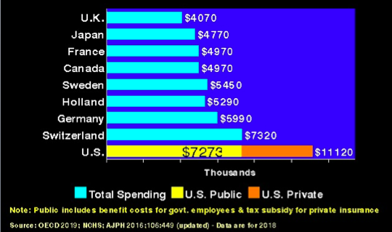
The US spends $11,000+ per person on healthcare — $7.3K from taxes plus $4K out-of-pocket —
Our public spending exceeds every other country’s total spending (except Switzerland, also $7.3)
$3,947
Notes:
This chart shows in turquoise the total cost of healthcare per capita for peer countries with universal healthcare that’s affordable for all their residents.
In yellow is the total cost of public funding for healthcare per capita in the US … that is how much of the cost of our HC is paid by taxes. We pay more in taxes for our HC than peer countries pay for ALL their HC … and then we lajd an extra $4K more in 2018 … and almost $5K more per capita today (for premiums and cost-sharing and out-of-pocket) … with many of our neighbors not seeing doctors and not getting care.

Slide 47
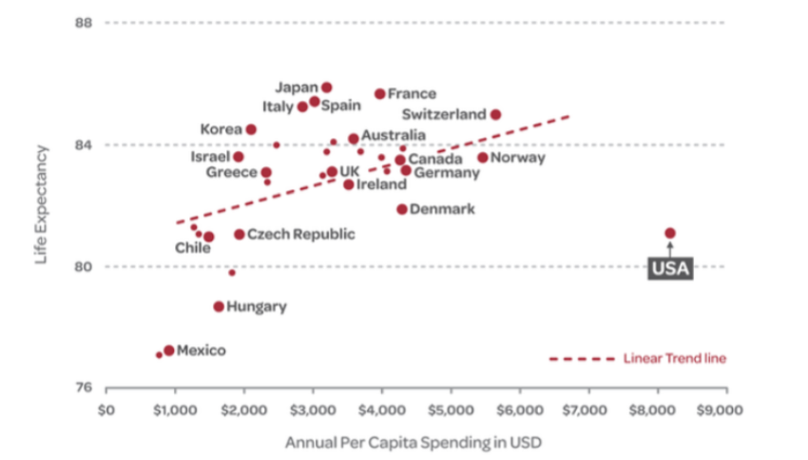
American life-expectancy at birth is 3-5 years less than peer countries but we spend twice as much on average
Notes:
The vertical axis charts life expectancy, the longer a country’s residents live, the higher on the chart is their dot. Note Japan and Italy near the top … but all the countries in the red box are higher than the US’s dot … their life expectancy is longer.
The horizontal axis charts how much HC costs (and mind you this chart goes back to 2016), and the US pays about twice the average of our peers noted inside the box.

Slide 48
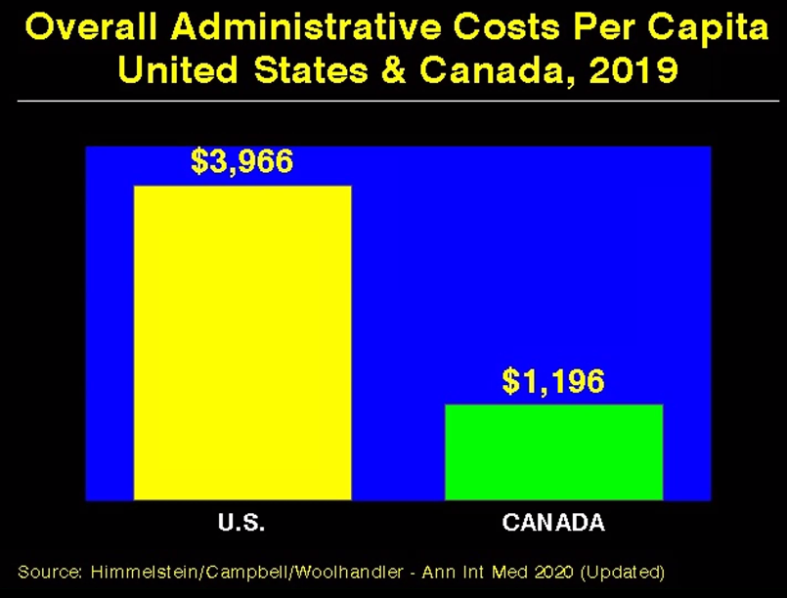
Almost $3,000 per person in excess administrative costs explains much of US excess total costs
$3K Excess
Notes:
In NYS administration eats up 11% of our healthcare dollars and about 30% of physican time. That’s why we won’t experience a physican shortage if we switch to a single payer plan, because it would drastically cut what we spend on administration in both time and money. Note that $3K in unnecessary billing and administration is a very large portion of how much more the US spends … per the charts offered earlier.

Slide 49
With universal healthcare Black soldiers and veterans live longer
Parity with Whites
Worse outcomes
Better outcomes
2015
Notes:
Note CAD event stands for coronary artery disease event … so kinds of heart attack
As an illustration of how access to affordable, reliable healthcare, this study form 2015 shows that Blacks experience no health disadvantage in VA care.

Slide 50
With universal healthcare racial disparities nearly disappear for Black soldiers and veterans
VA AND MILITARY OUTCOMES
2017
Notes:
Here are more examples of how access to affordable reliable health care can eliminate racial disparities.

